Slide 1

Exploratory Data Analysis
Haipei Xu
07/21/2024

Slide 2
Contents
Background
Data Preprocessing
Problem Statement
EDA
Recommendations

Slide 3
Background –G2M(cab industry) case study
The Client
XYZ, a private firm in the US, is planning to invest in the cab industry and seeks to understand the market dynamics before making a decision.
Project Delivery
You are provided with four datasets containing information on two cab companies. Your task is to analyze these datasets and generate insights to help XYZ identify the best investment option.
Data Sets
Cab_Data.csv: Transaction details for two cab companies.
Customer_ID.csv: Mapping of unique customer identifiers to demographic details.
Transaction_ID.csv: Mapping of transactions to customers and payment modes.
City.csv: List of US cities, their population, and number of cab users.
Goal
To deliver a presentation with visuals, analysis, and recommendations to XYZ's Executive team, highlighting which cab company is a better investment opportunity.

Slide 4
Data Preprocessing
Check the field names and data types.
Identify missing values.
Handle the duplicates and outliers
Transform the time stamp
Add additional features
Tables merge

Slide 5
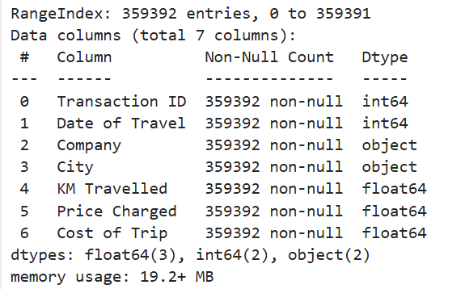
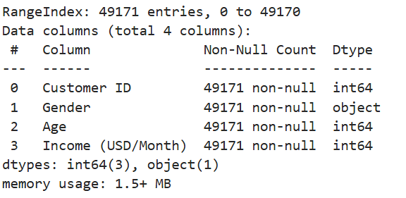
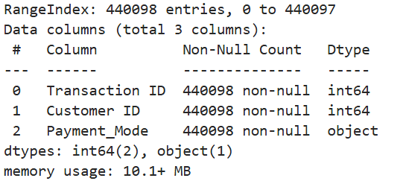
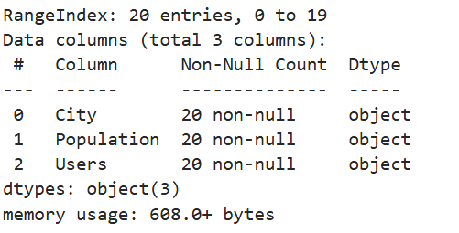
Data Preprocessing

Slide 6
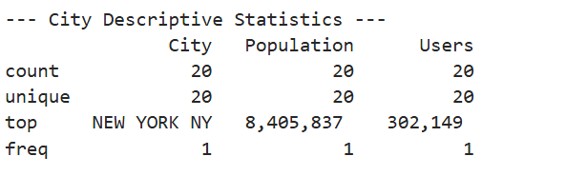
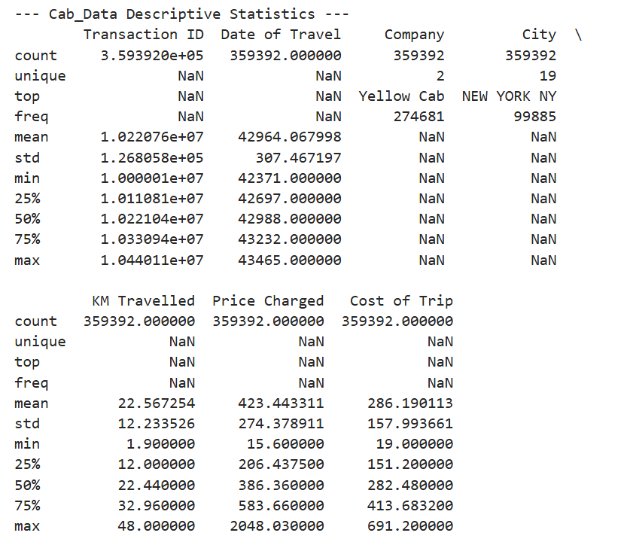
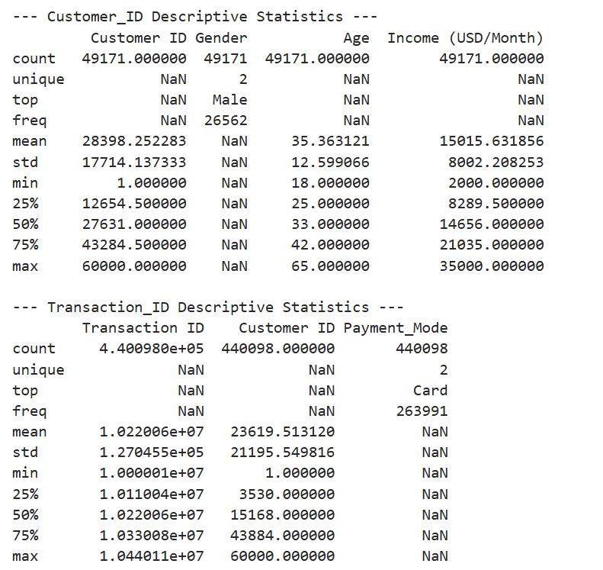
Data Preprocessing

Slide 7
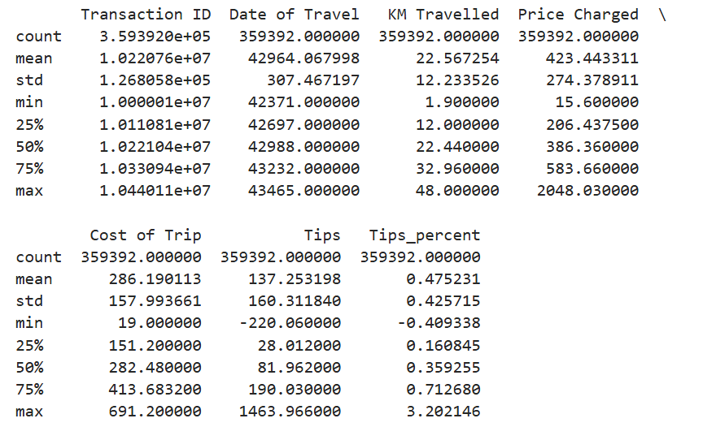
Data Preprocessing
Add two columns:
Tips = Price Charged - Cost of Trip
Tips_percent = Tips / Cost of Trip

Slide 8
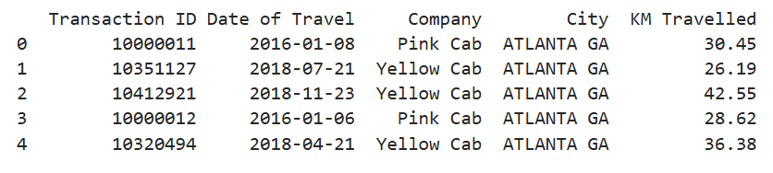
Data Preprocessing
Transformation of the time stamp:

Slide 9
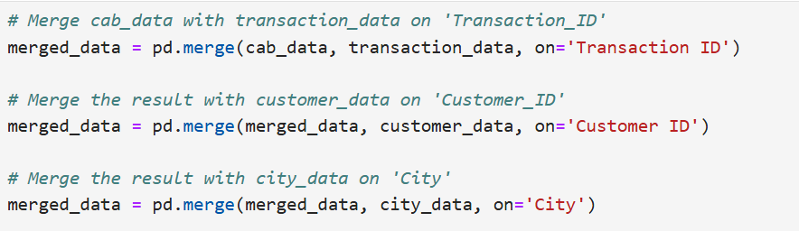

Data Preprocessing

Slide 10
Problem Statement
Before doing the EDA, I need to clarify the problems I want to solve and the conclusion I want to draw:
The changes in customer traffic and total revenue of these two companies over time
Which city has the highest number of customers and the average price of fees charged to each customer
Which city do these two cab companies primarily operate in
Which city do wealthy people live in, and which company's car do they take
Which company has a higher total taxi mileage
Is the proportion of tipping higher for long-distance trips and wealthy people
After answering these six questions, I think I can comprehensively analyze these two companies and give reasonable and wise advice to XYZ’s Executive team.

Slide 11
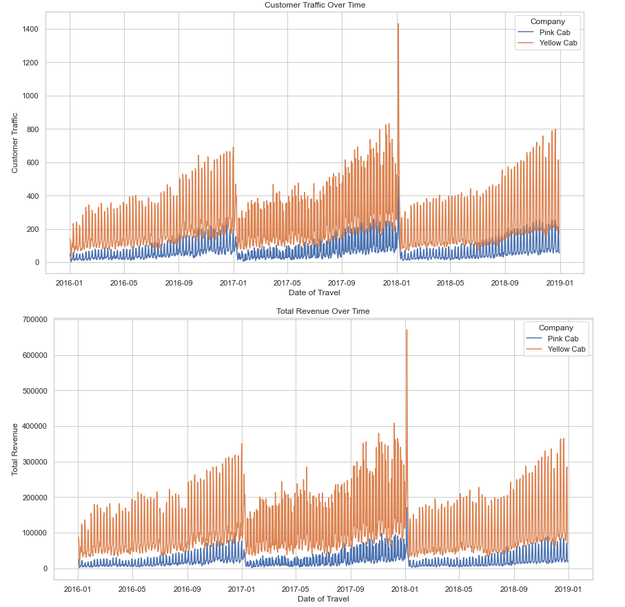
EDA
The changes in customer traffic and total revenue of these two companies over time
Analysis:
Conclusion:

Slide 12
EDA
Analysis:
The figures indicate the superiority of Yellow Cab over Pink Cab in terms of total revenue and customer traffic. Both metrics increase monotonically within a year, with the second half of each year being the peak period, especially in December. This surge is likely due to holidays like Christmas and Thanksgiving.
Conclusion:
Based on this comparison, I recommend XYZ invest in Yellow Cab. To maximize profits, consider the following strategies:
Increase year-end traffic by providing better subsidies to drivers.
Offer attractive discounts to passengers.
These actions can boost revenue and strengthen customer loyalty.

Slide 13
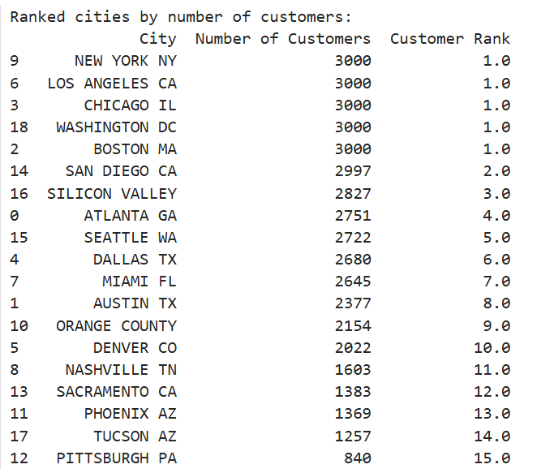
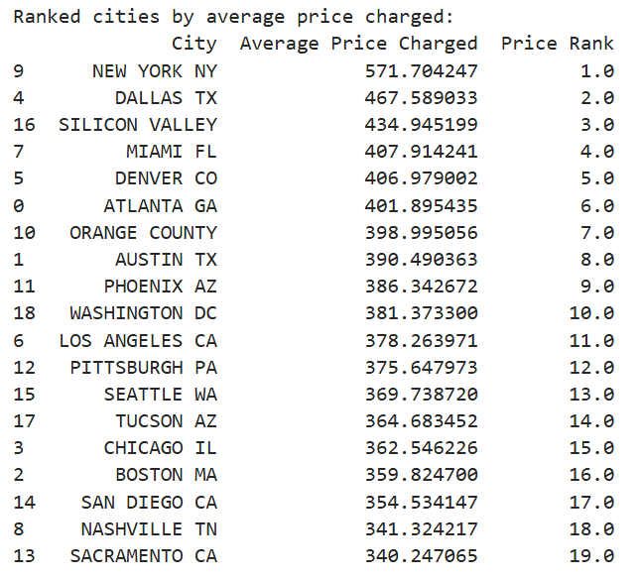
EDA
Which city has the highest number of customers and the average price of fees charged to each customer

Slide 14
EDA
Analysis:
The cities with the highest customer numbers are New York, NY; Los Angeles, CA; Chicago, IL; Washington, DC; and Boston, MA, all having 3000 customers. New York has the highest average fee per customer at $571.7, significantly higher than Dallas, the second highest, at $467.6.
Conclusion:
We classify New York, Los Angeles, Chicago, Washington, DC, Boston, and San Diego as first-class cities due to their high customer numbers. New York stands out with the highest revenue per customer, indicating its potential for maximum profit, despite higher driver salaries. If XYZ wants to maximize earnings, investing in New York and these first-class cities is essential.

Slide 15
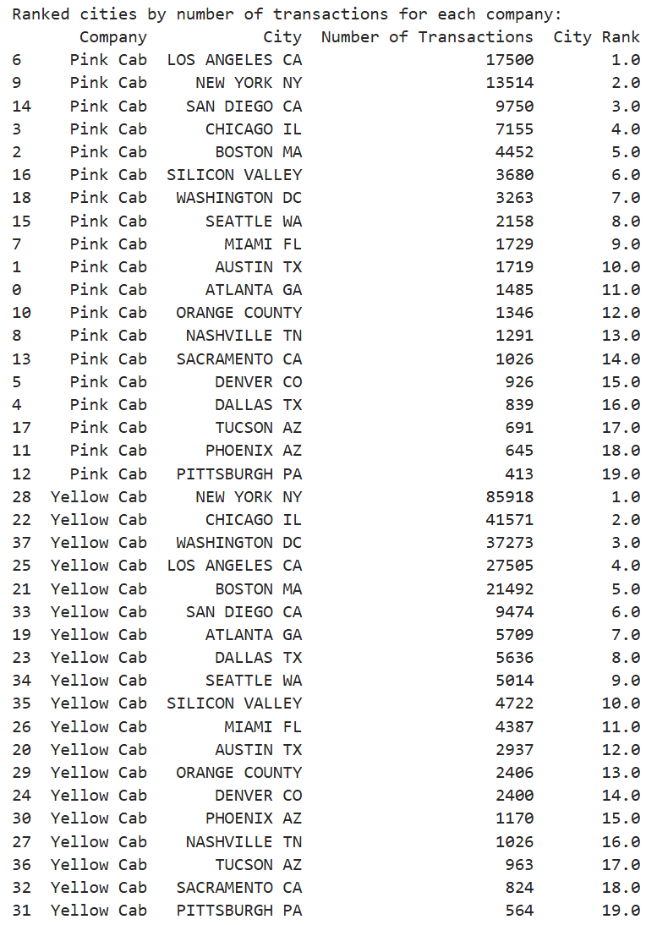
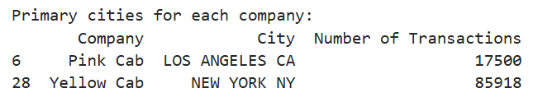
EDA
Which city do these two cab companies primarily operate in

Slide 16
EDA
Analysis:
Yellow Cab primarily operates in New York, while Pink Cab is more active in Los Angeles.
Conclusion:
Yellow Cab's strategic focus on New York allows it to capitalize on higher revenue opportunities. Both companies have significant passenger flow in first-class cities, which is promising for potential investments. To maximize earnings, investing in Yellow Cab in New York and expanding operations in other first-class cities is essential.

Slide 17
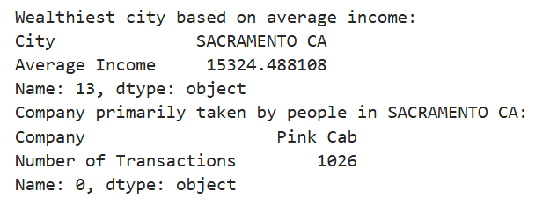
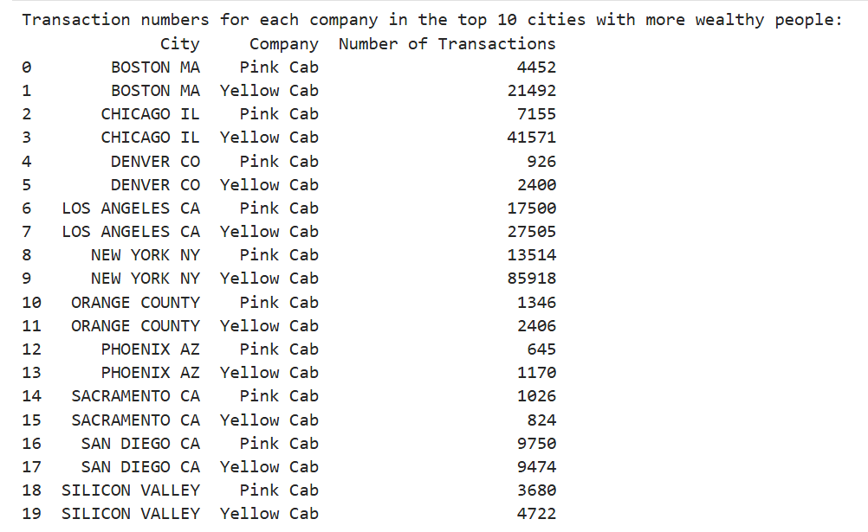
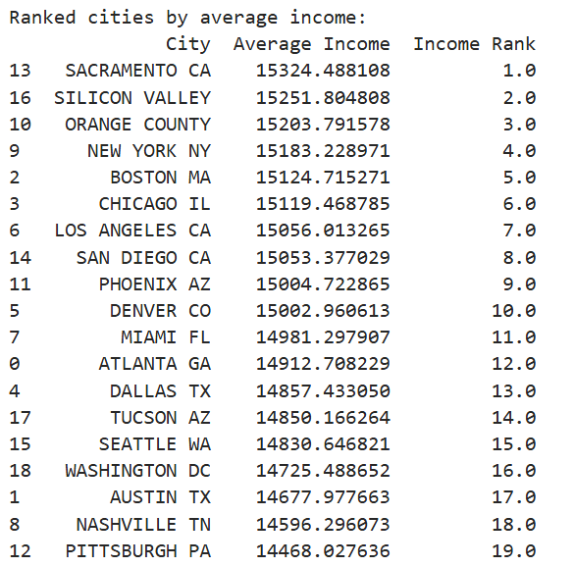
EDA
Which city do wealthy people live in, and which company's car do they take

Slide 18
EDA
Analysis:
In Sacramento, CA, taxi passengers have the highest average income. Pink Cab has 1,026 transactions, surpassing Yellow Cab's 824.
Conclusion:
While Pink Cab has an edge in Sacramento, Yellow Cab outperforms in other wealthy cities. These stats might not fully represent the wealthiest individuals, who likely own cars. Therefore, cab companies should also focus on cities that may not be the wealthiest but have a high demand for taxi services, as they might house the richest taxi users.

Slide 19
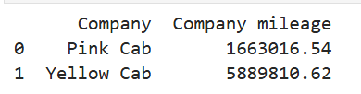
EDA
Which company has a higher total taxi mileage
Analysis:
Yellow Cab has a significantly higher total taxi mileage (5,889,810 miles) compared to Pink Cab (1,663,016 miles), nearly 3.5 times more.
Conclusion:
This data indicates that Yellow Cab operates on a larger scale with more taxis and greater mileage, making it a more attractive investment. However, the high mileage also suggests potential wear and tear, highlighting the need for regular safety checks to mitigate any safety hazards. This ensures vehicle reliability and passenger safety, which are critical for sustained business success.

Slide 20
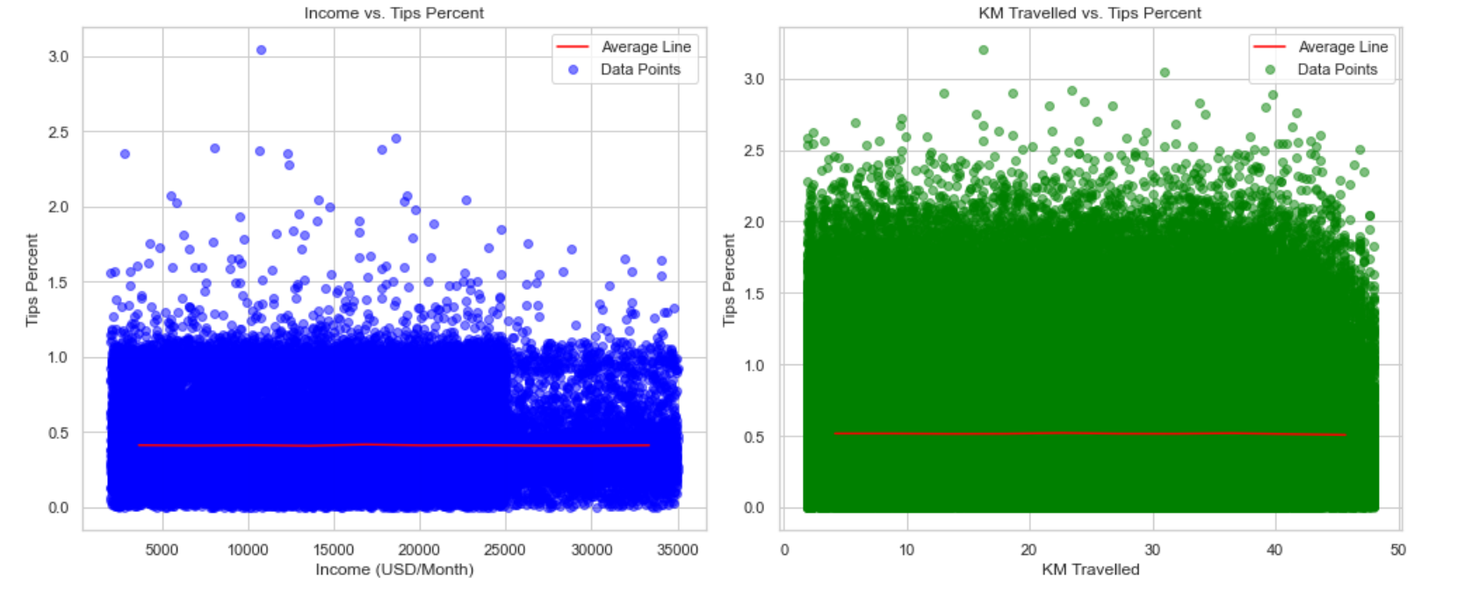
EDA
Is the proportion of tipping higher for long-distance trips and wealthy people¶

Slide 21
EDA
Analysis:
The tips rate appears unrelated to the distance traveled (KMs) or the customers' incomes.
Conclusion:
It seems there was a misconception regarding the "tips." Tips are not influenced by other factors like income or distance traveled; instead, they tend to be a stable value when considering a large number of samples.

Slide 22
Recommendations
Invest in Yellow Cab Company for the following reasons:
Higher Profit Potential: Consistently higher revenue in key cities like New York, Los Angeles, and Chicago.
Strategic Market Presence: Focus on high-demand areas ensures steady revenue.
Operational Efficiency: Larger fleet and greater mileage indicate robust operations.
Customer and Driver Incentives: Better subsidies and discounts can boost revenue and loyalty.
Targeting Diverse Markets: Dominance in affluent cities and potential in less affluent areas.
Vehicle Safety: Regular safety checks maintain reliability and operational standards.
Conclusion: Yellow Cab's strategic presence, operational efficiency, and high return potential make it a wise investment.

Slide 23
Thank You

